Slide 1
Procedures
Md. Shahidul Salim
Farhan Sadaf

Slide 2
The 8086 CALL and RET Instruction
CALL instruction performs 2 operations.
It stores the return address on the stack
Change the contents of IP and in some cases , CS

Slide 3
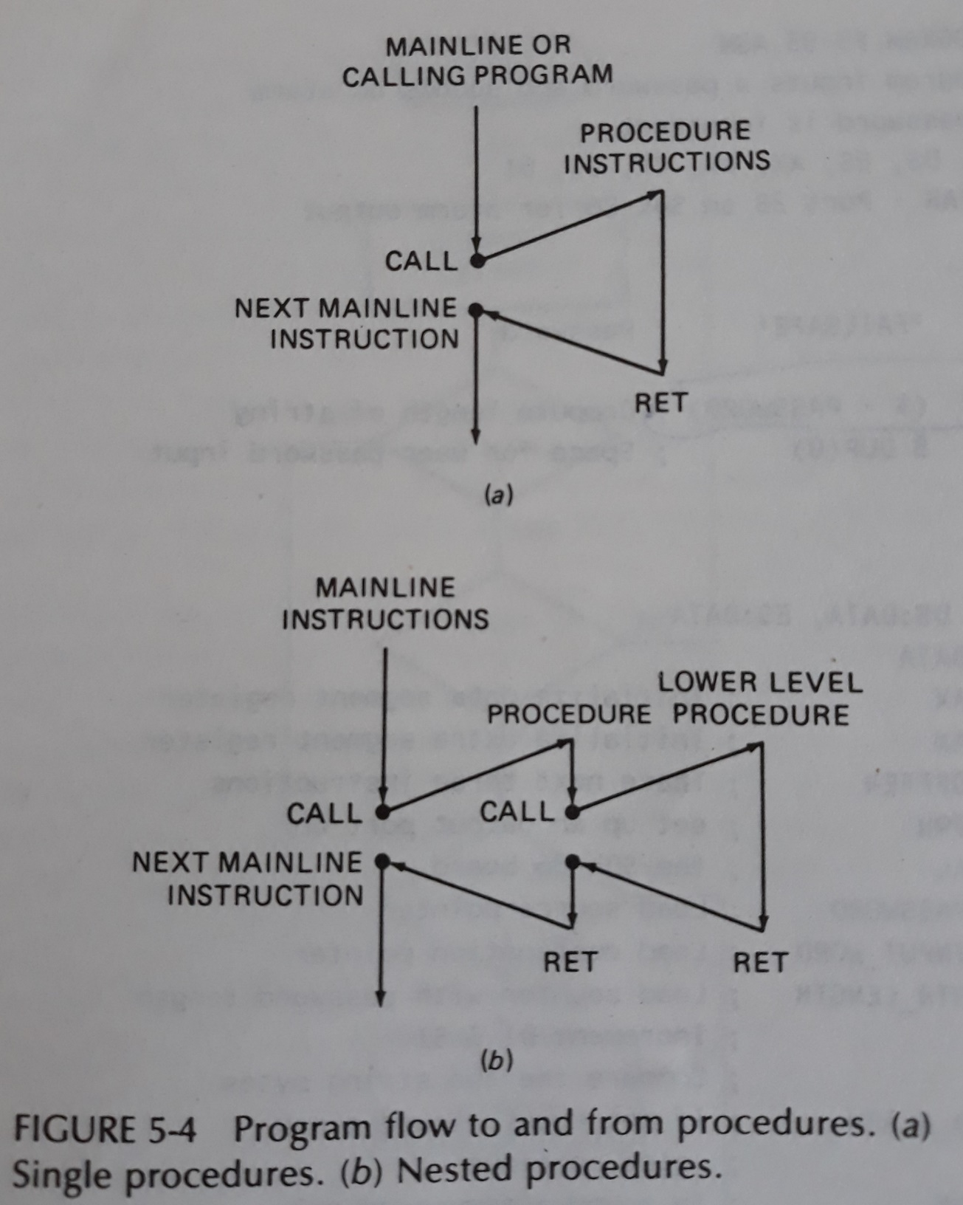
Single and Nested Procedure

Slide 4
Passing Parameters to and from Procedures
4 major ways:
Passing parameters in registers
Passing parameters in general memory
Passing parameters using pointers
Passing parameters using the stack

Slide 5
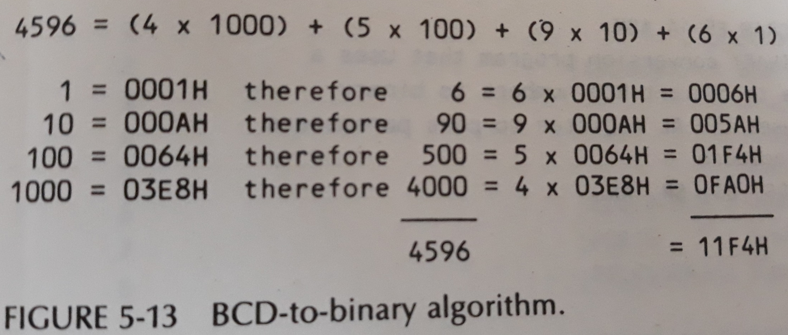
BCD to Binary

Slide 6
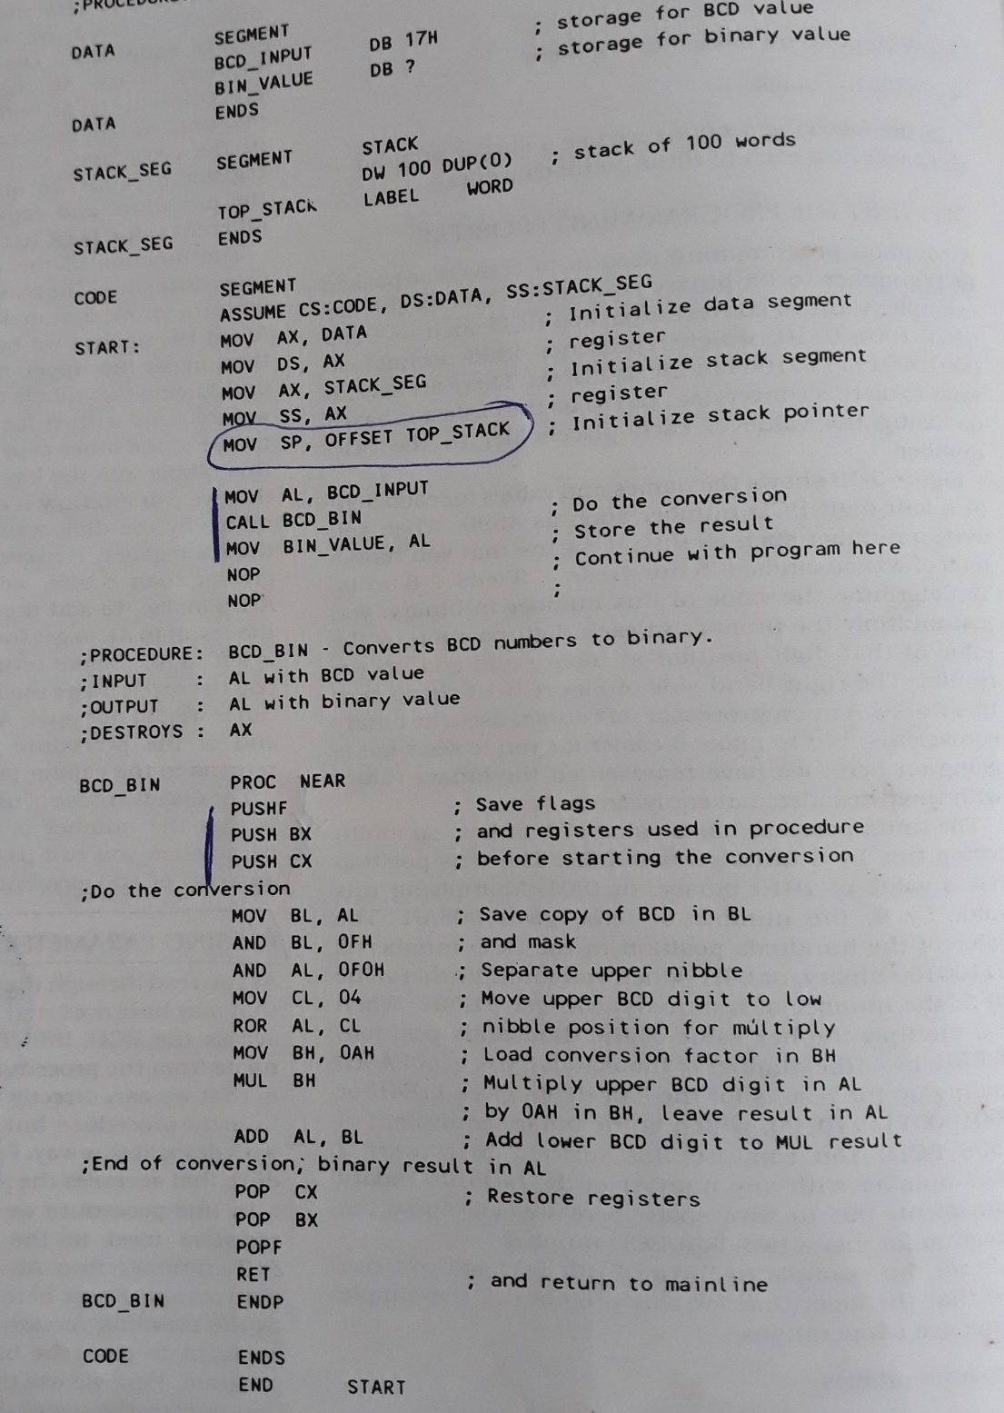
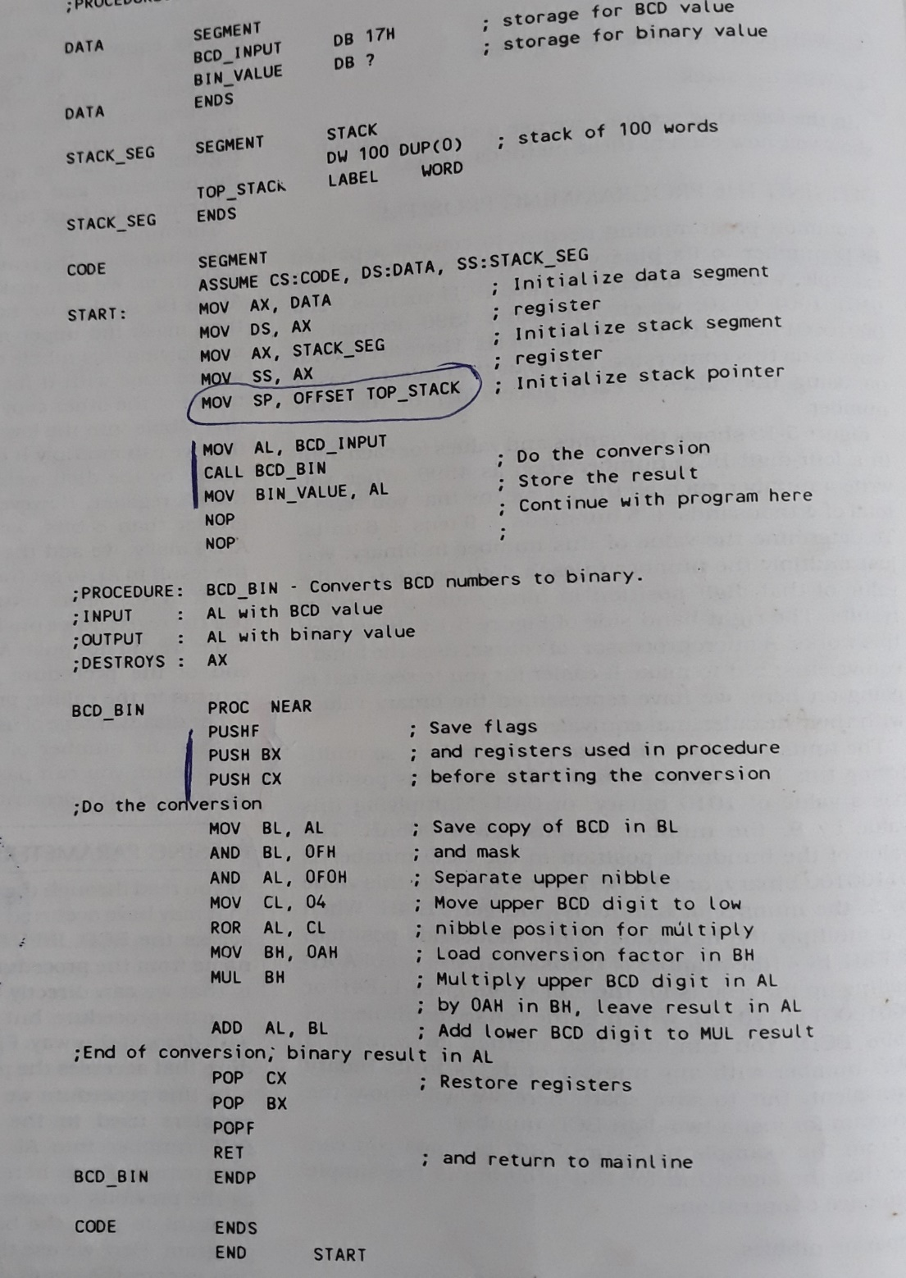

Passing parameters in registers

Slide 7
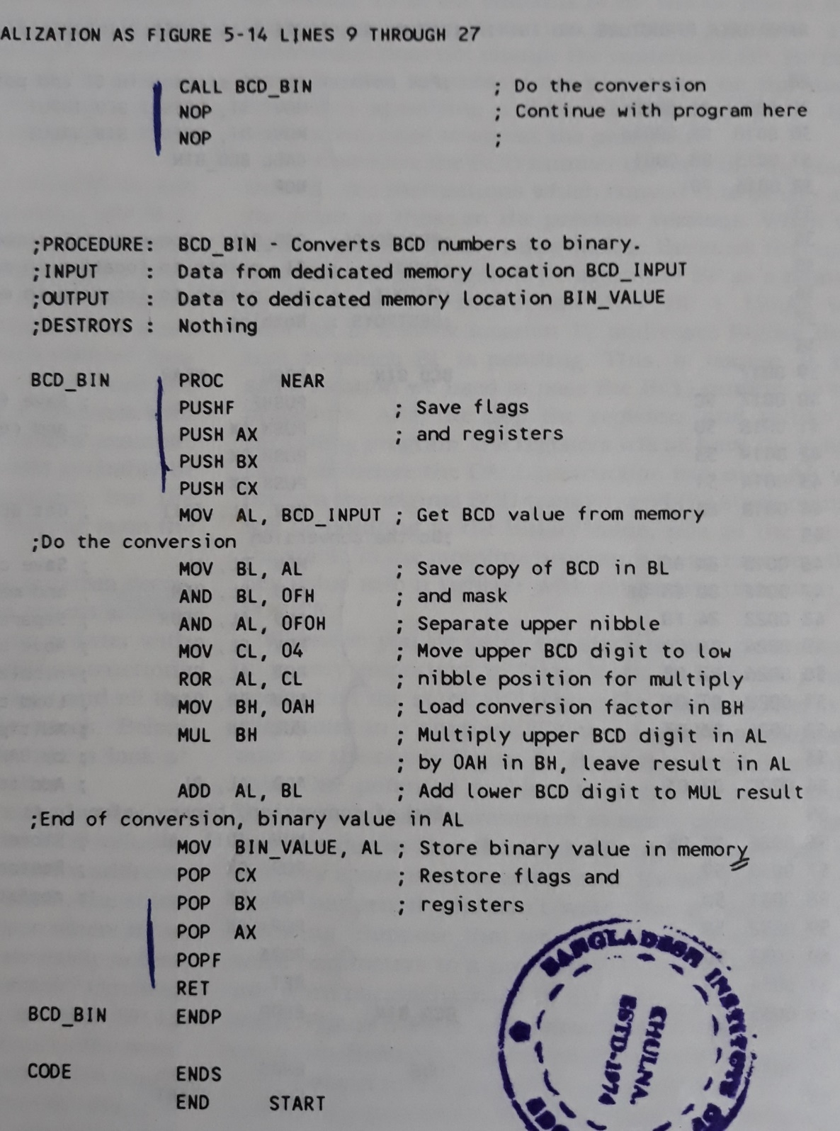
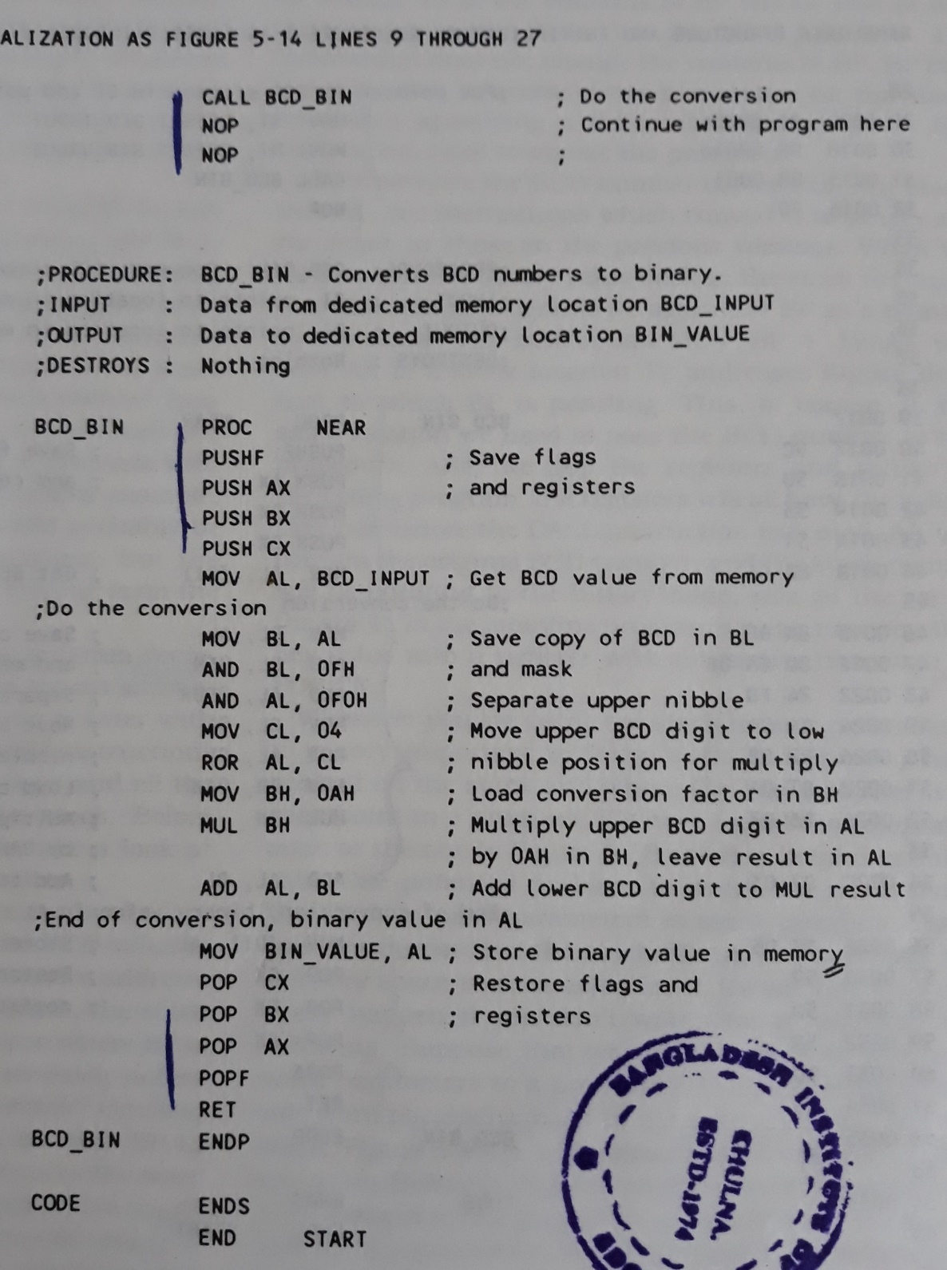
Passing parameters in general memory

Slide 8
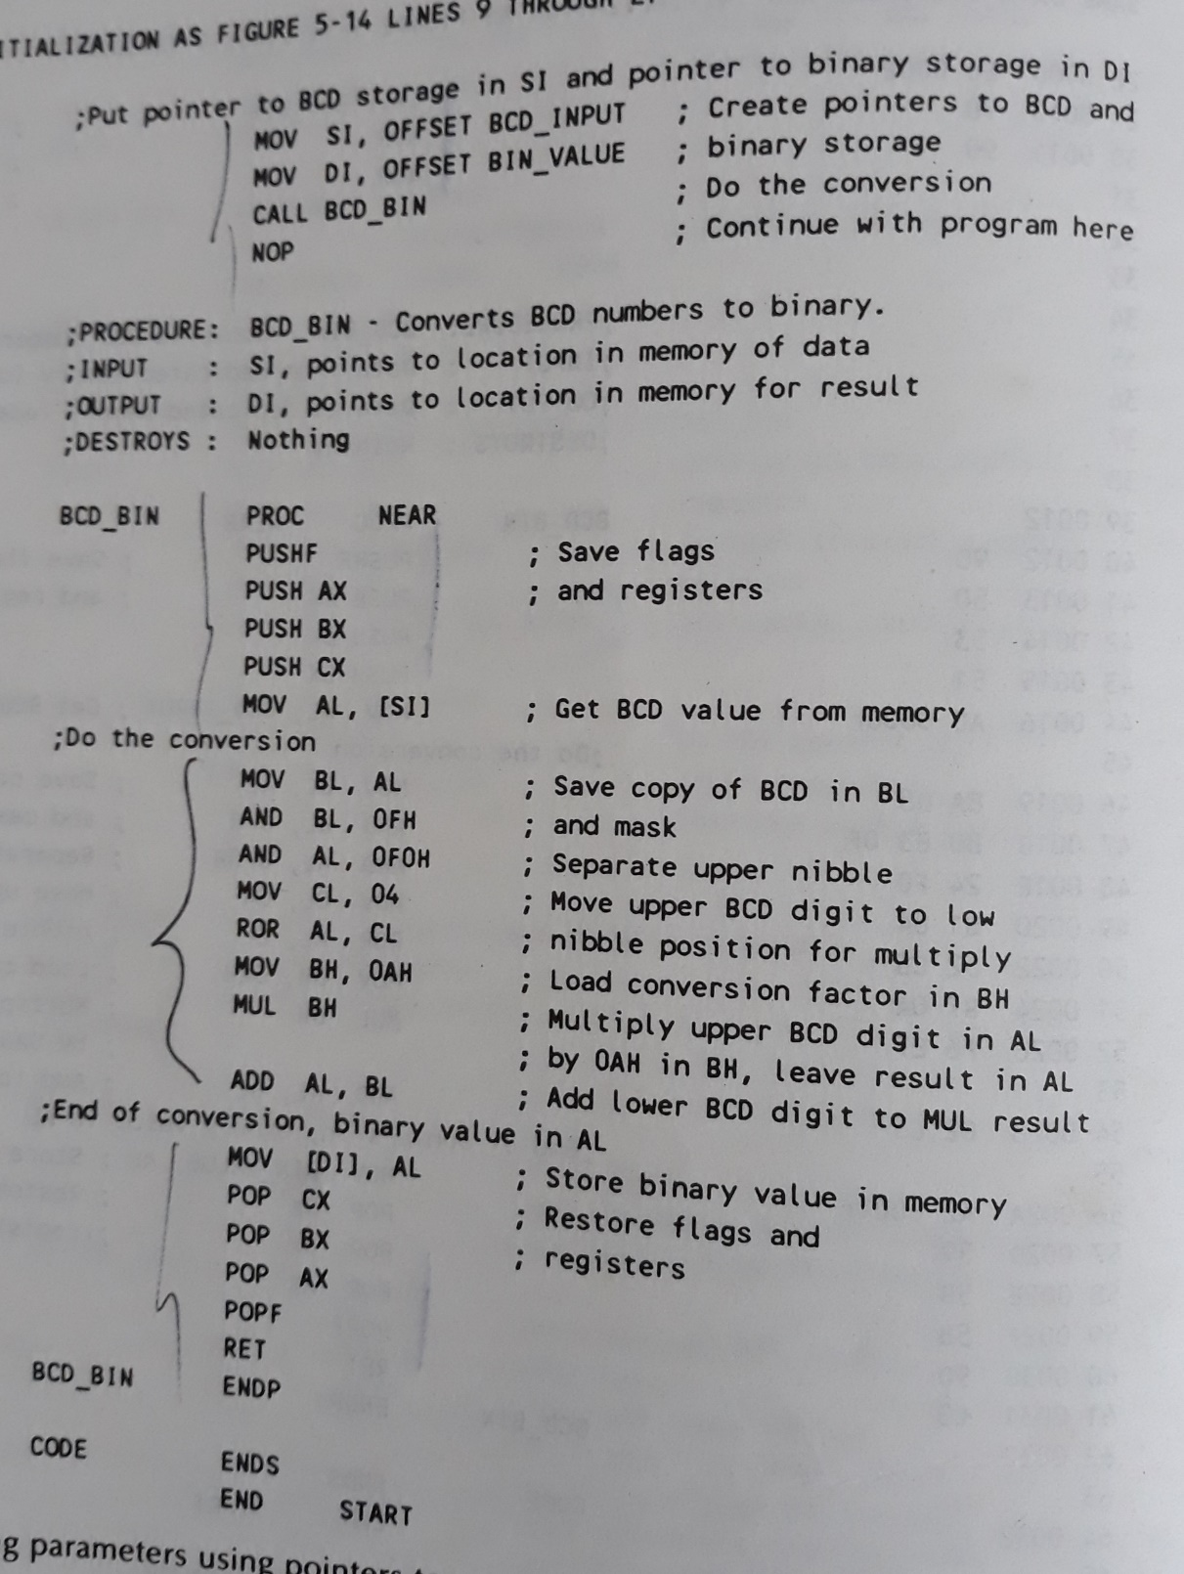
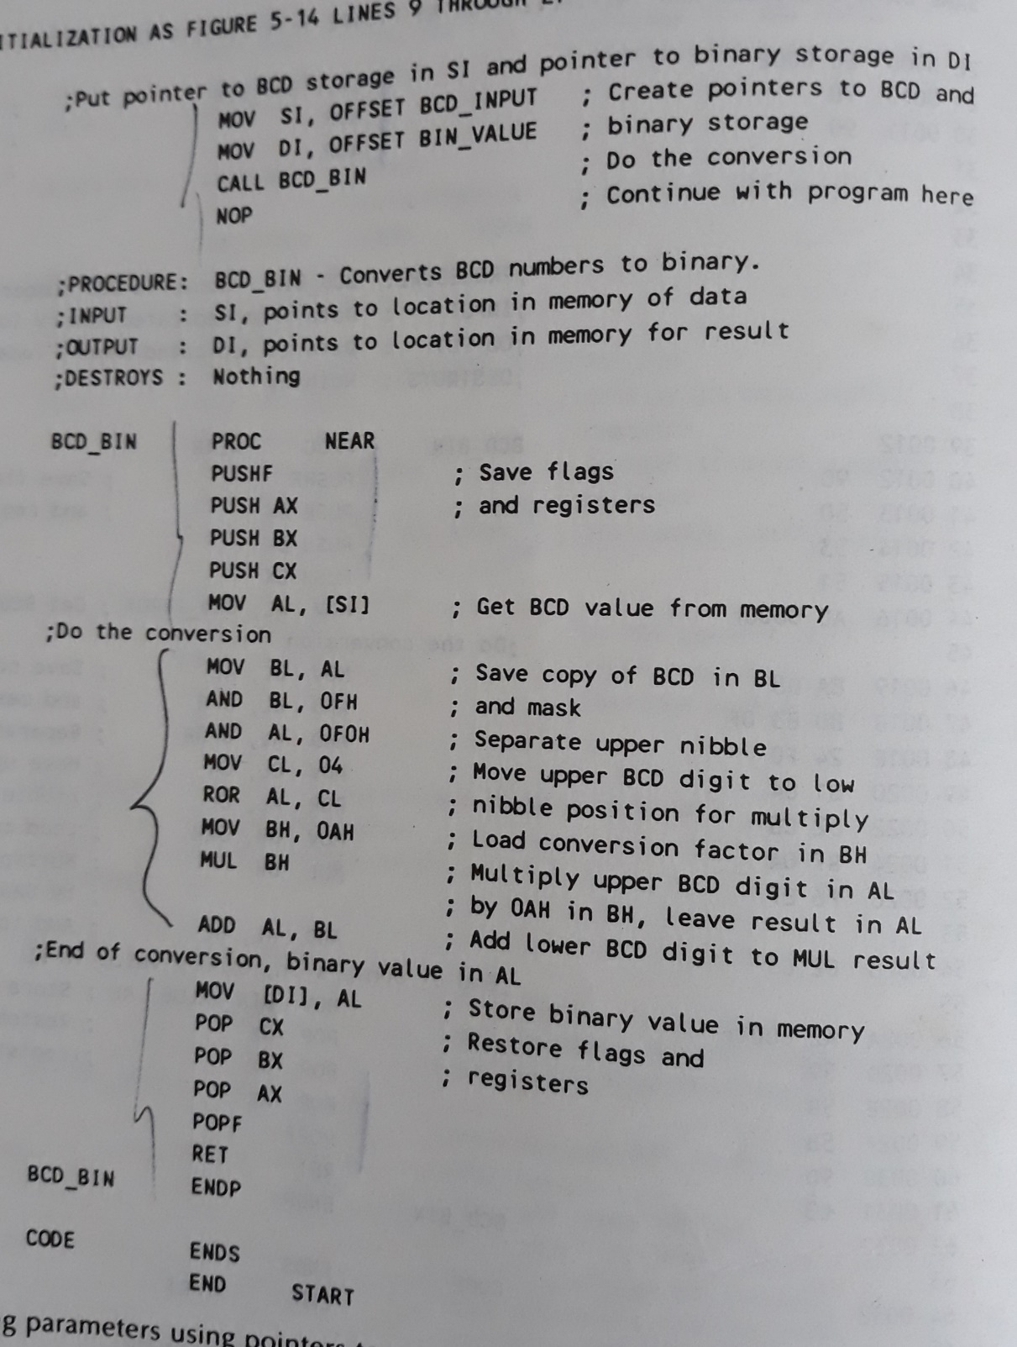
Passing parameters using pointers

Slide 9
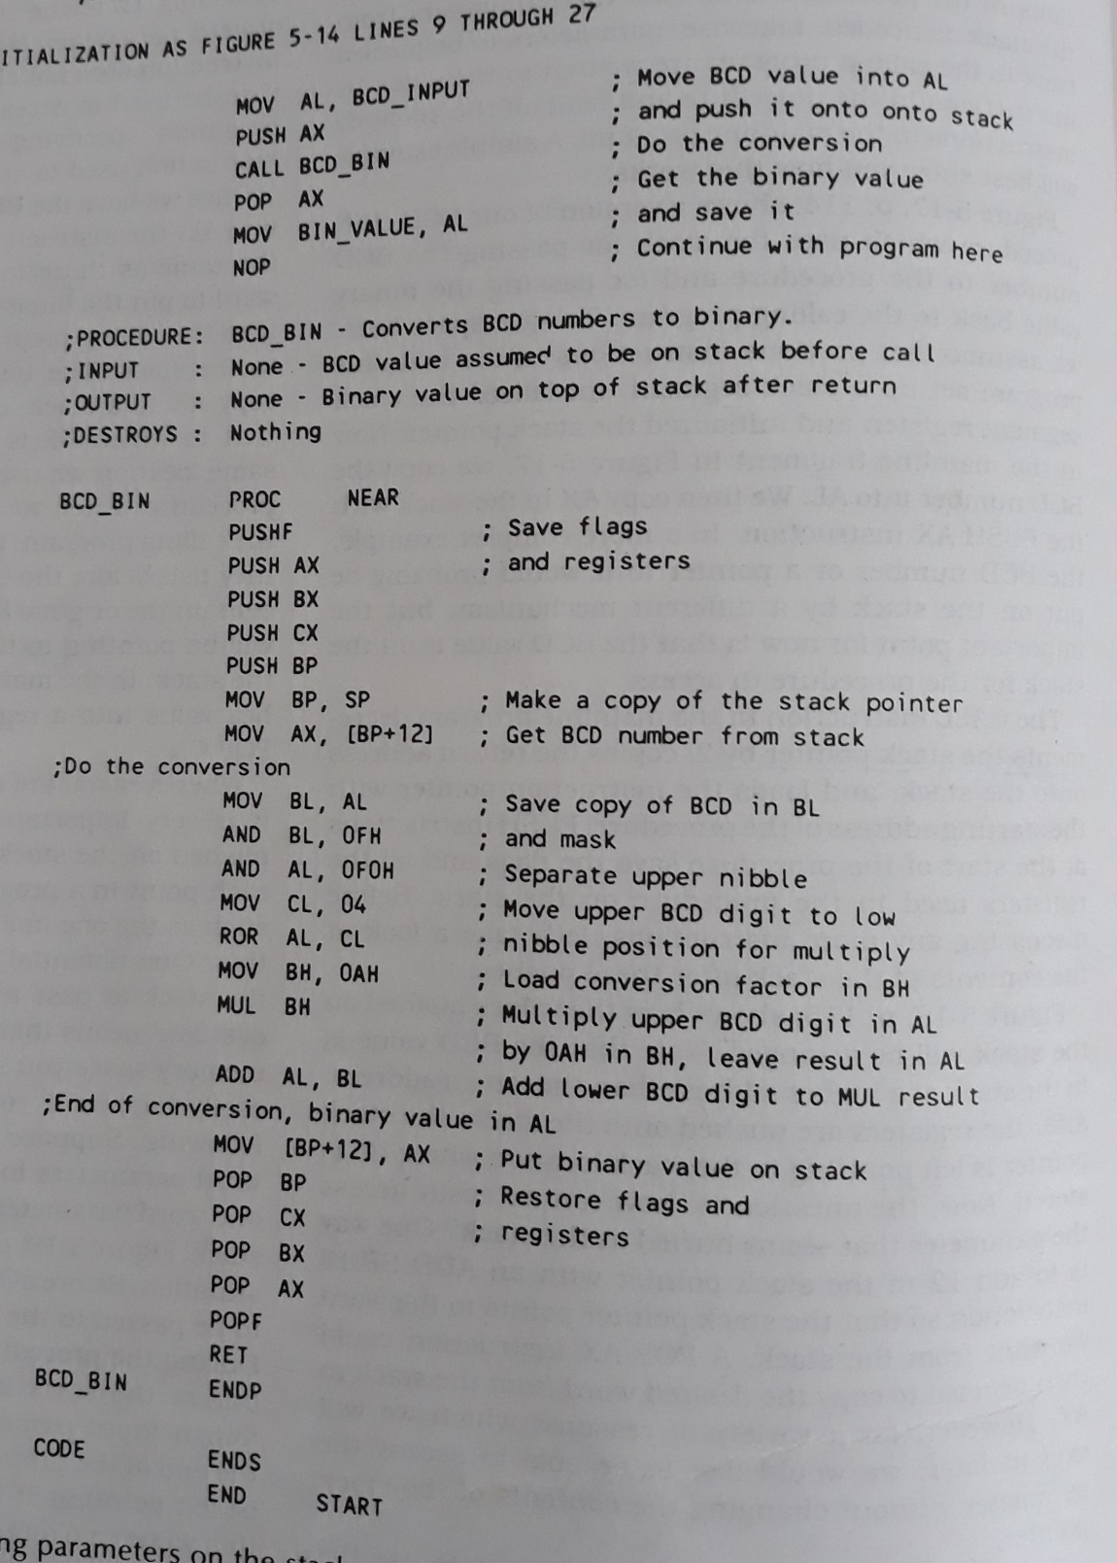
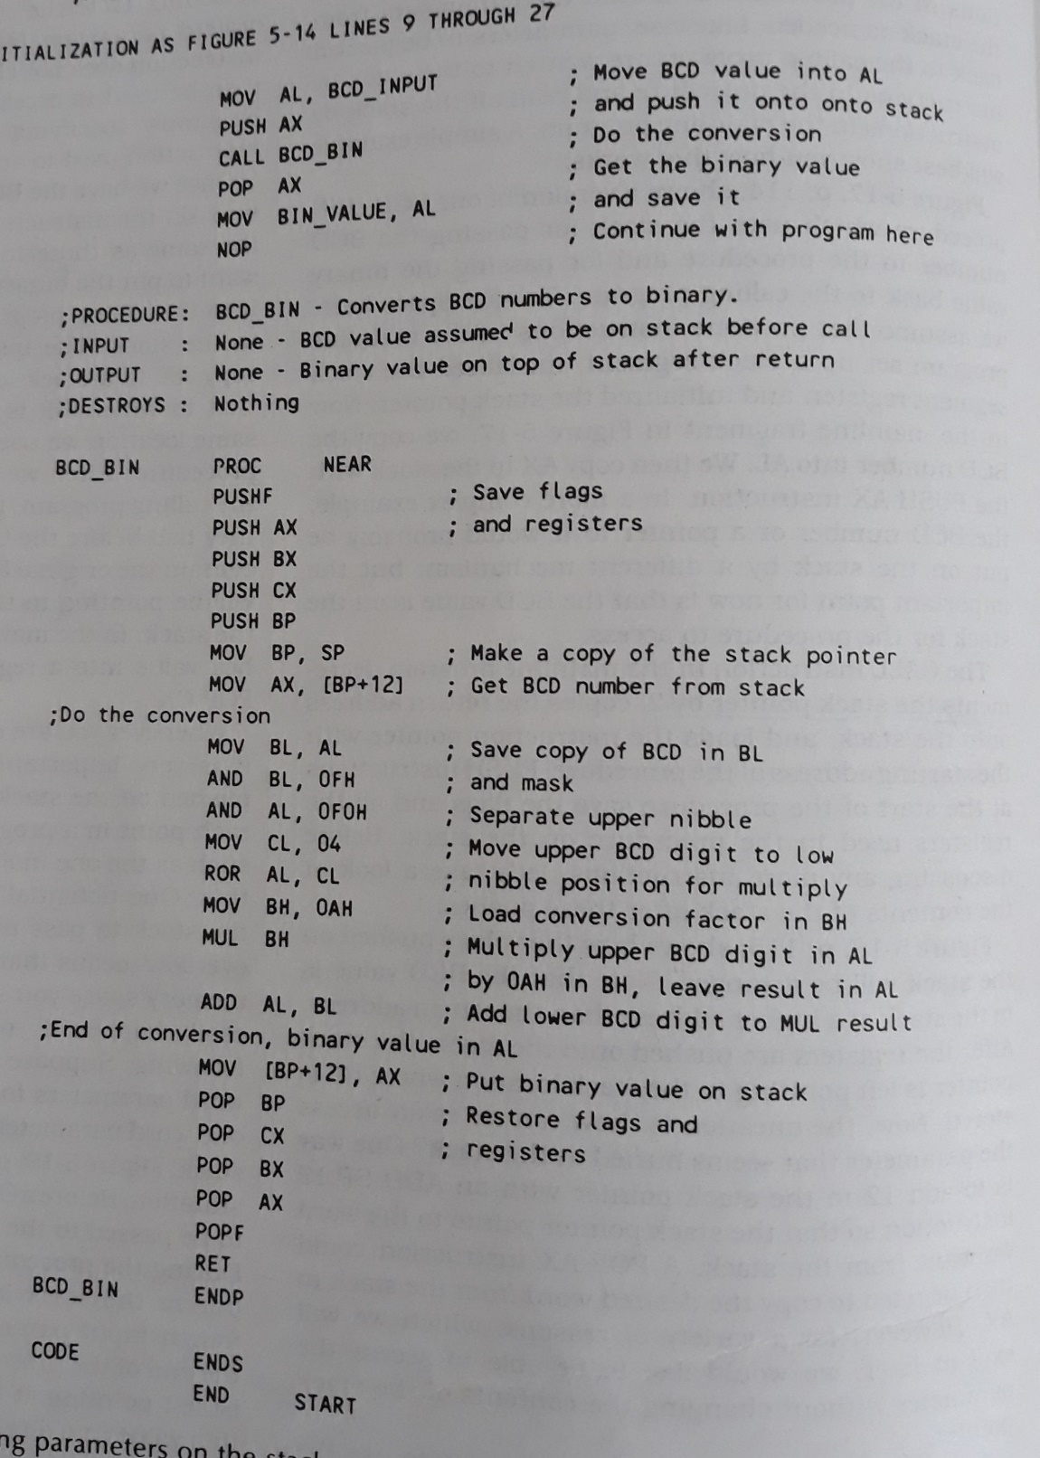
Passing parameters using the stack

Slide 10
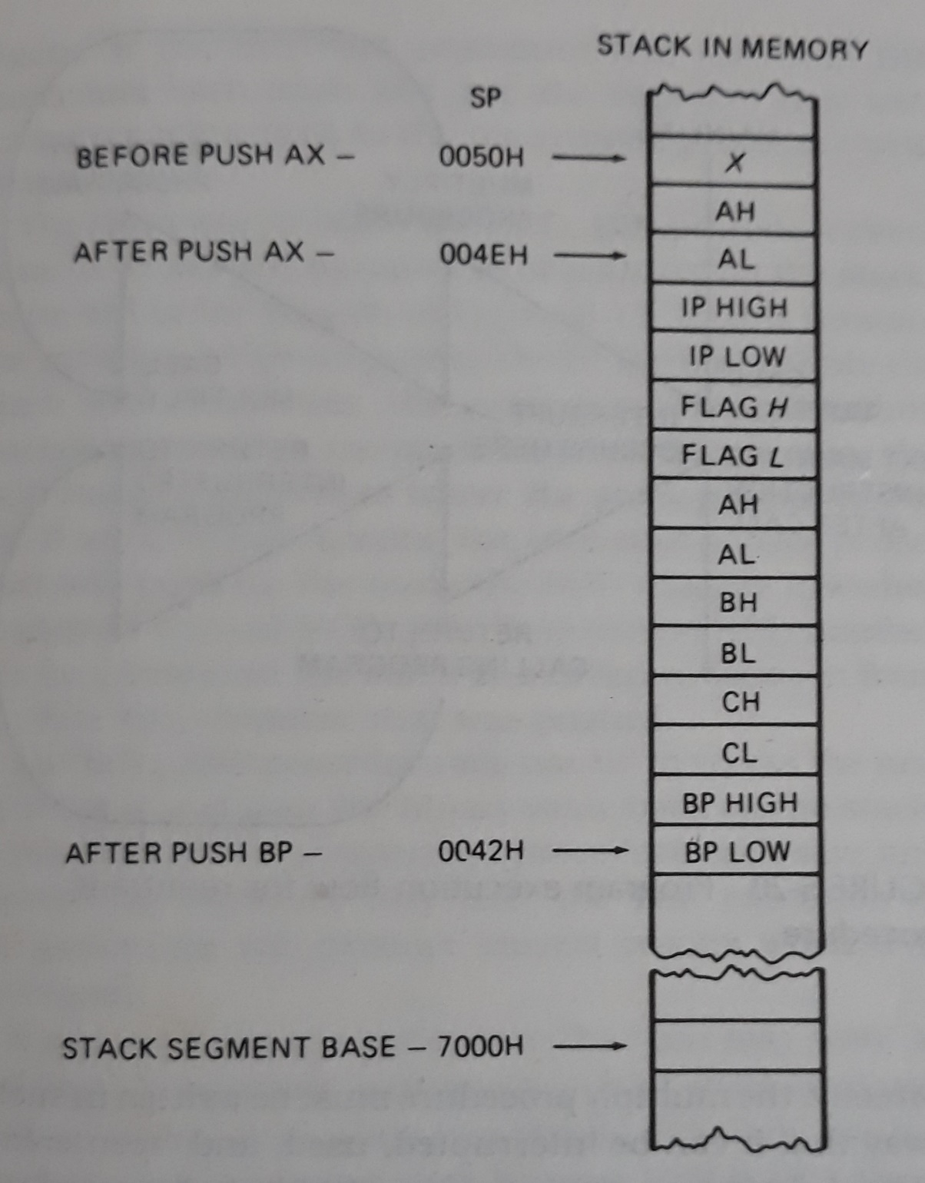

Slide 11
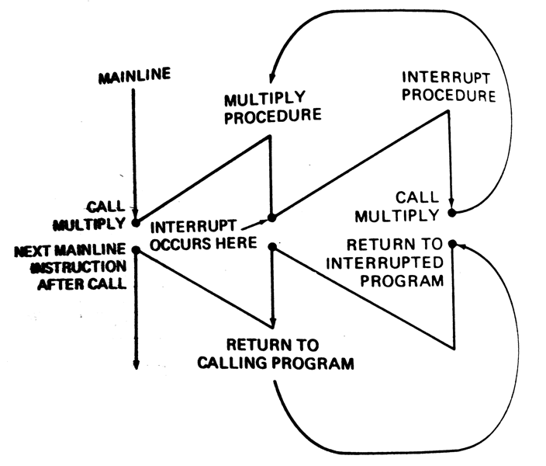
Reentrant Procedures

Slide 12
Recursive procedures
A recursive procedure is a procedures which call itself.
If N = 1 THEN factorial = 1
ELSE factorial = N * (factorial of N-1)

Slide 13
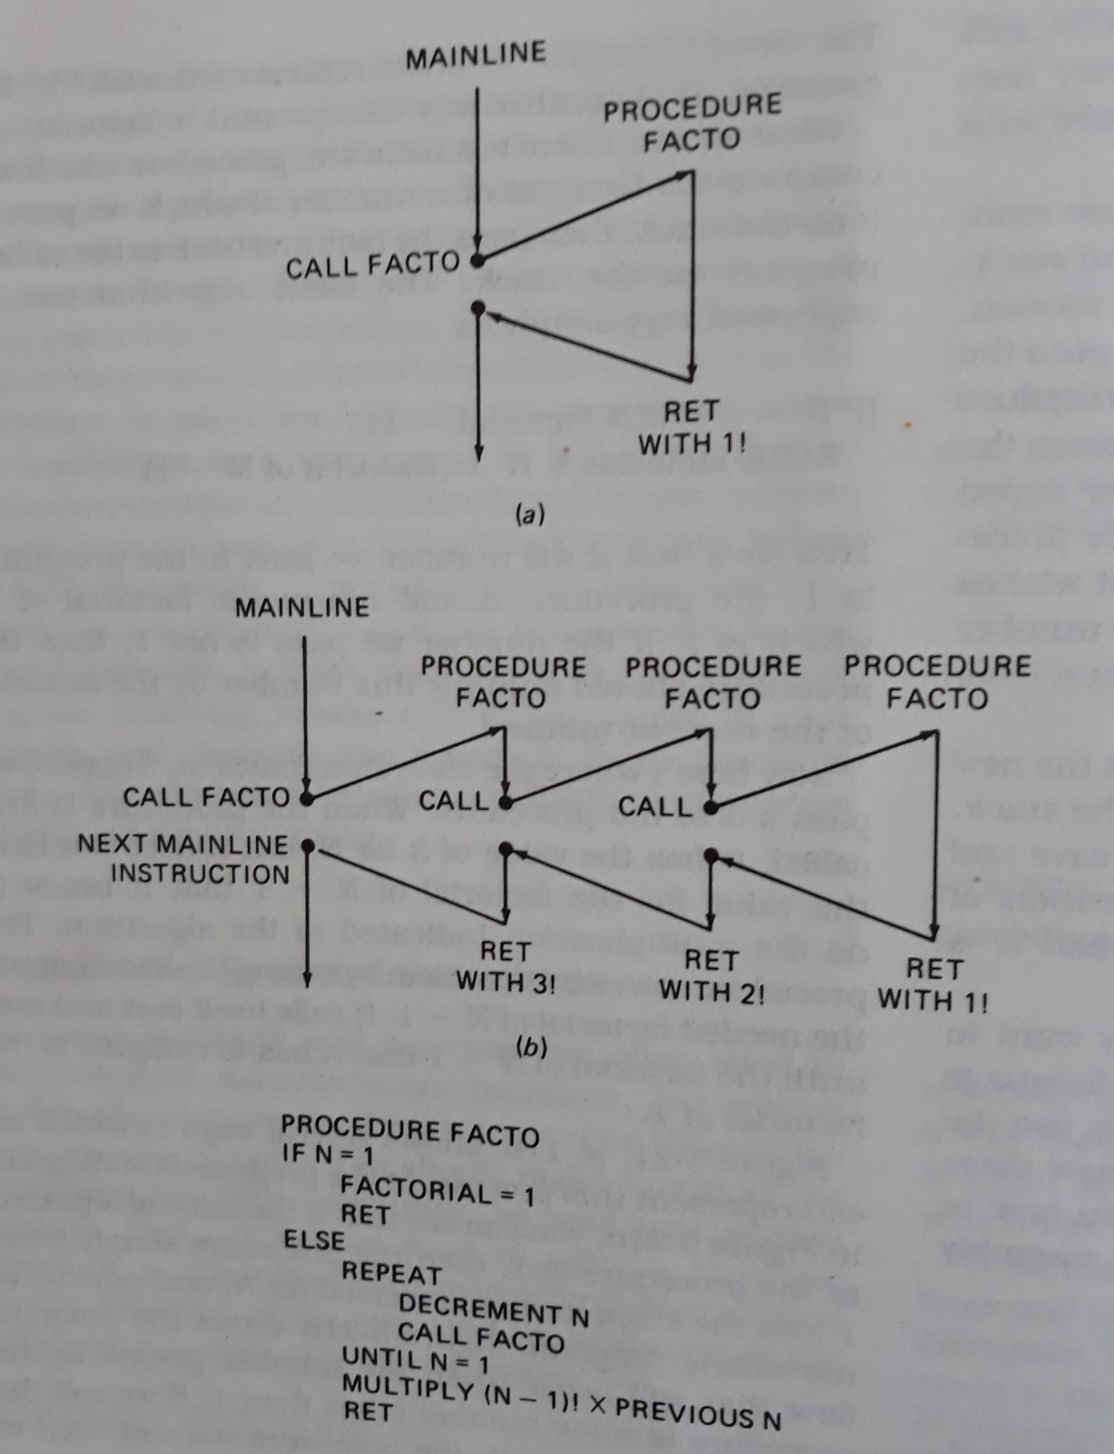
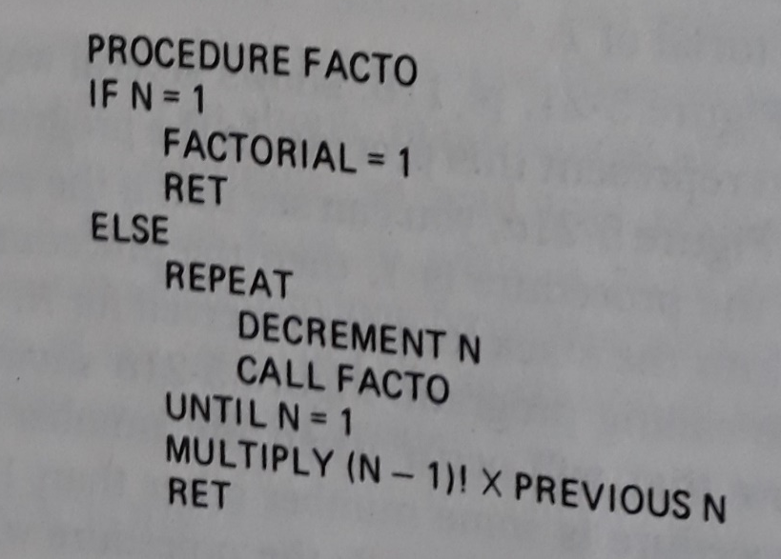
Factorial

Slide 14
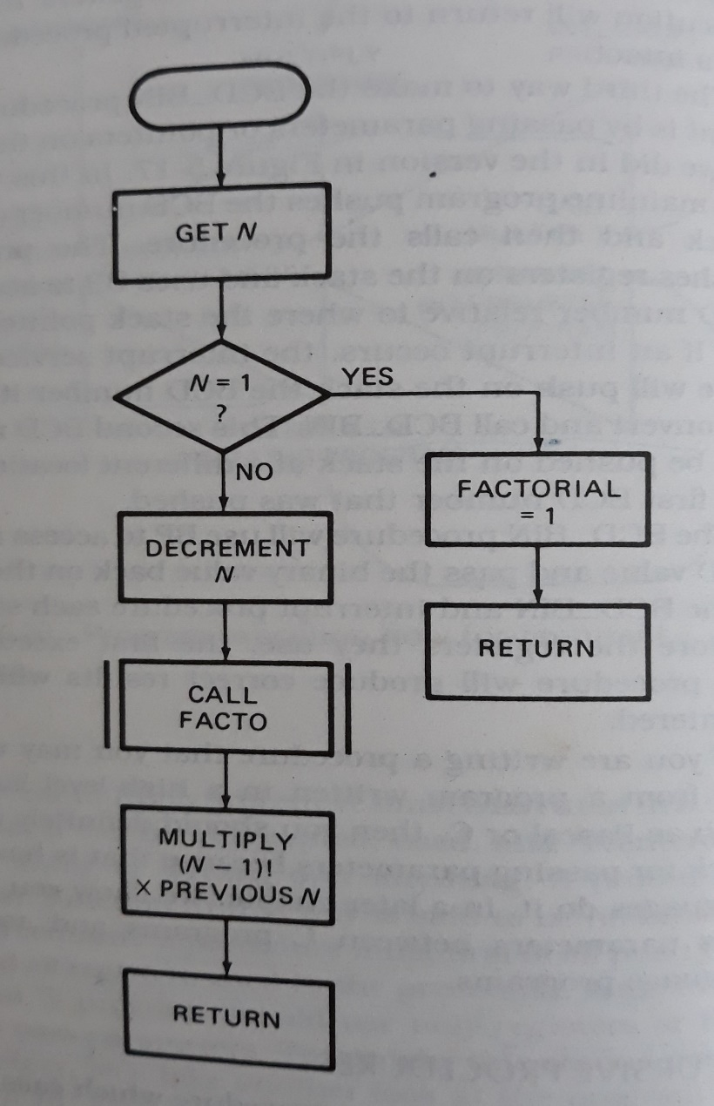
Flowchart

Slide 15
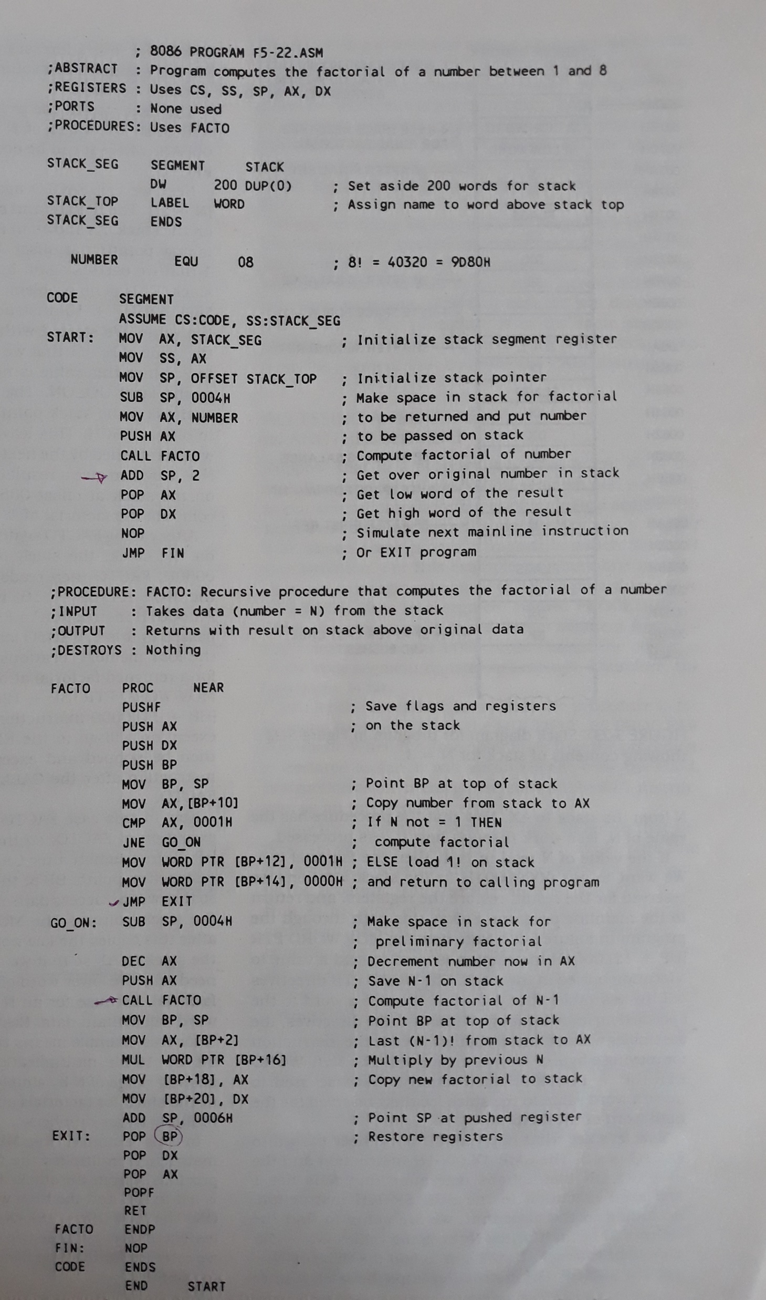
Calculate factorial of a number between 1 and 8

Slide 16
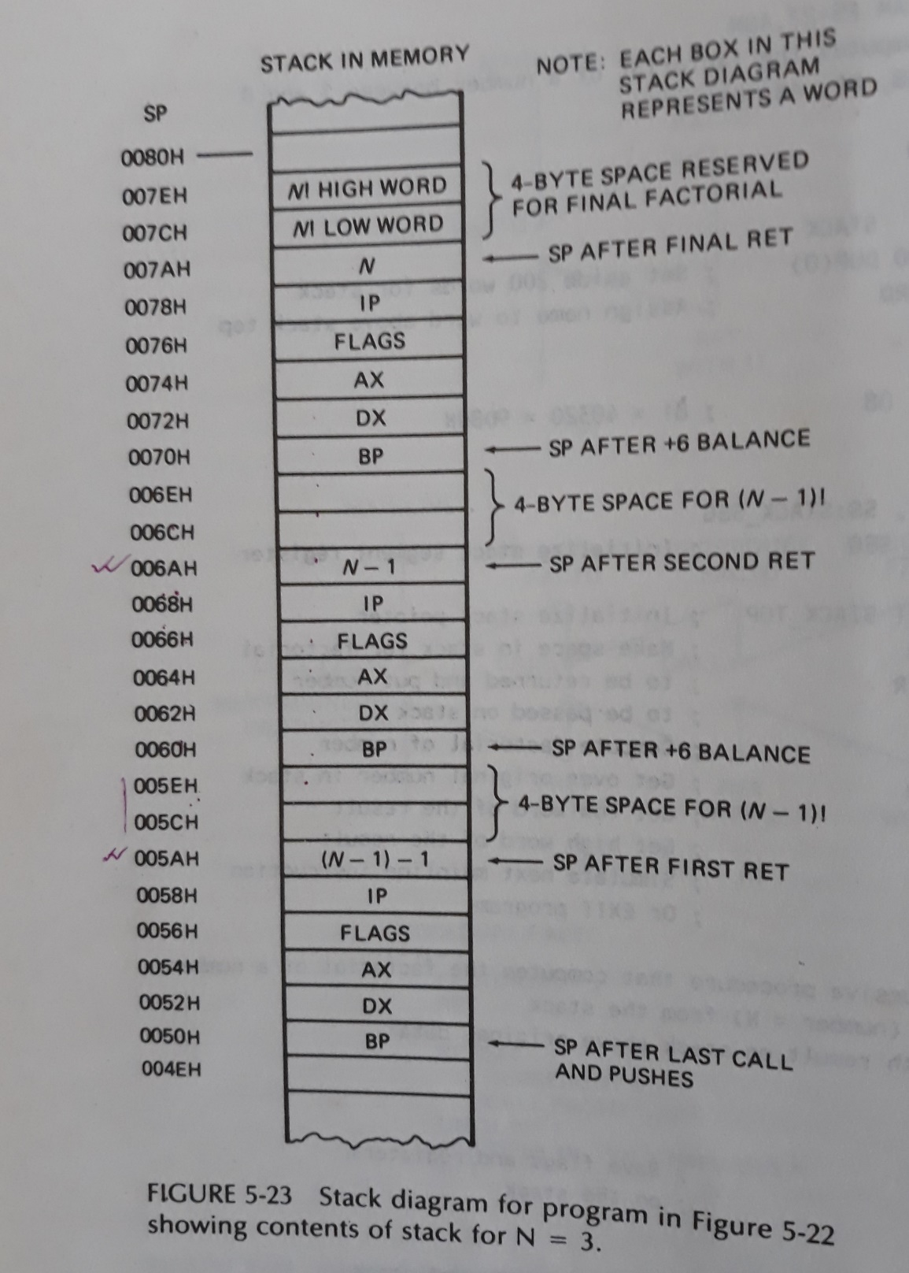

Slide 17
MACROS
A macro is a group of instructions we bracket and give a name at the start of the program.
Defining and calling macros without parameters:
PUSH_ALL MACRO
PUSHF
PUSH AX
PUSH BX
ENDM

Slide 18
Passing parameters to Macros
MOVE_ASCII MACRO NUMBER, SOURCE, DESTINATION
MOV CX, NUMBER
LEA SI, SOURCE
LEA DI, DESTINATION
CLD
REP MOVSB
ENDM
MOVE_ASCII 03DH, B_ST, B_ND

Slide 19
References
Microprocessors and Interfacing: Programming and Hardware Douglas V. Hall

